Slide 1
Voice-Controlled Thumper Vehicle
Milestone III - First Prototype
Ahmed Leithy 900160088
Yahia Farid 900161331
Yousef Koura 900160083

Slide 2
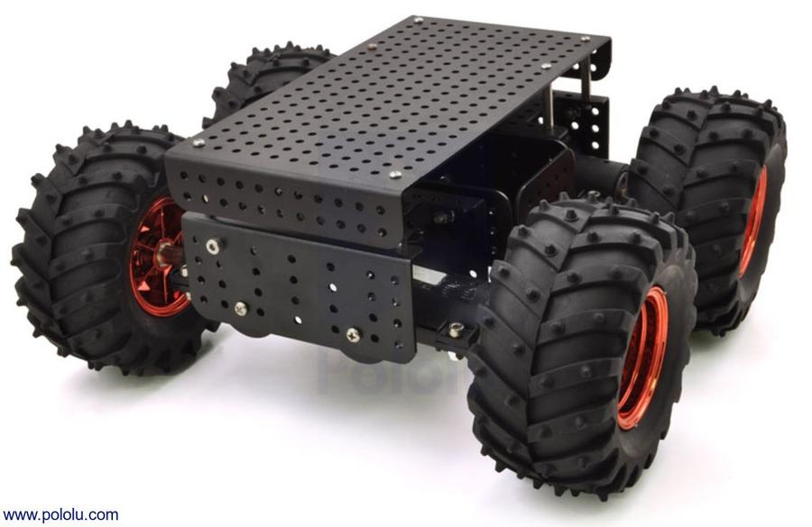

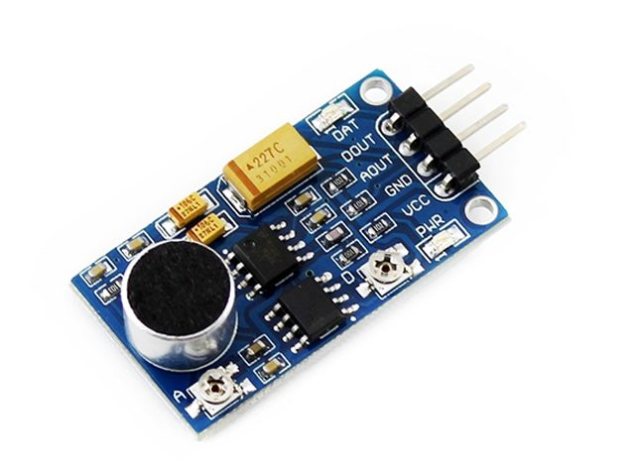
Progress
Thumper Vehicle
TensorFlow Lite for microcontrollers
Microphone(s)

Slide 3
Thumper Vehicle
Built on what was done in the lab
Edited the code to be more modular
Tested the needed commands

Slide 4



Tensorflow Lite for Microcontrollers
Attempted to set it up using Linux but faced several problems
Used Windows (with Linux LTS) to finally set it up after several days
Needed to install another IDE: STM32CubeIDE
Tested simple (pre-generated) model that roughly estimates a sine wave
Confirmed that it works (matching sample output) with a few tests

Slide 5
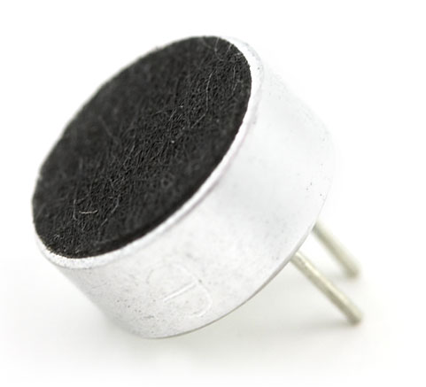
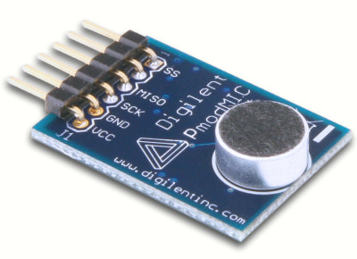
Microphones
Electret Microphone (Bought)
Digilent PmodMIC (AUC)
May need an amplifier as value changes are small
Variable DC value that is not shunted by capacitor
Experimented with different capacitor and resistor values
Extremely brief datasheet
Constant DC value
Very Noisy output

Slide 6
Next Milestone
Already ordered a new sound detector with several integrated functionalities - should arrive today!
Train/find a model for speech recognition (microspeech)
Integrate all aforementioned components together

Slide 7
Thank You!

